Slide 1
intro

Slide 2
What we chose
We chose the provided case study for the team project which was to create a software for an on-line supermarket.
The requirement of the case study is to produce a software that meets the four cores, which include loyalty scheme, payment, marketing and supplier interface.
The group is made up five so we produced an additional core which is analytics, which is simply an analysis of the software's performance.

Slide 3
Meet The Team
Akber – Project Manager / Suplier
Sabaa – Core Devloper
Abdala - Marketing
David – Payment
Subodh – Loyalty Scheme

Slide 4
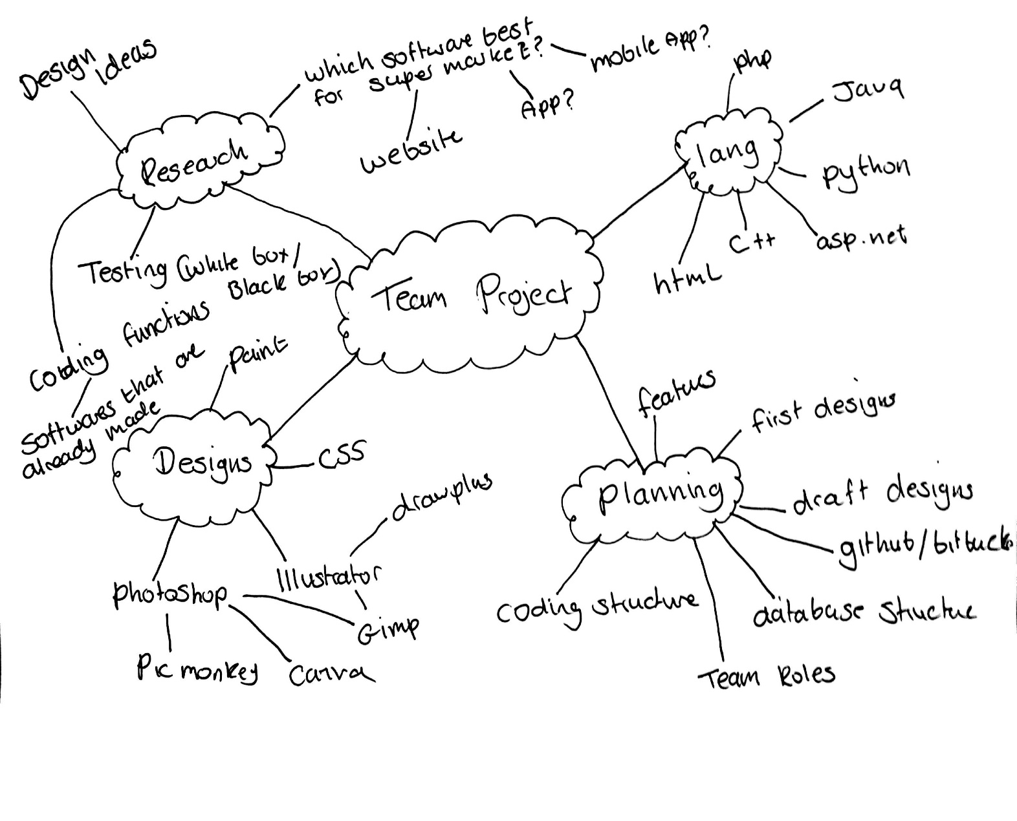
Planning
The course of action we took towards the planning of the project was brain storming.
This was basic but effective as it encouraged group members to provide their ideas and perspective on the project.

Slide 5
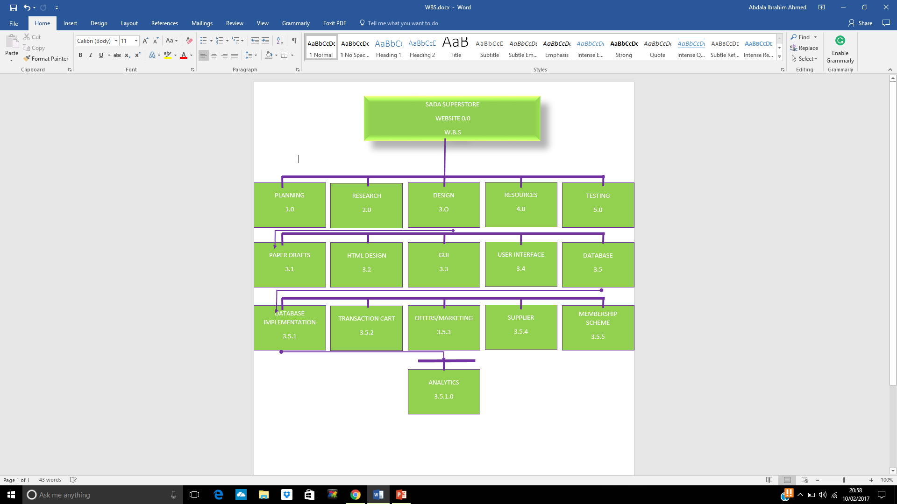
WBS (Work Breakdown Structure)

Slide 6
Loyalty Scheme
Loyalty Scheme

Slide 7
Payment

Slide 8
Marketing
Marketing is where a business creates new ways in which it can improve the performance of sales in hopes of increasing profit.
A business can do this by tracking consumer purchase, and by doing so can offer promotions and offers on popular products.
I approached this core by first researching the offers and promotions of other companies such as Tesco and Sainsbury for a better insight.
In doing so it has helped in deciding on offers and promotions that we will integrate into the software.

Slide 9
Marketing-Software
[The code will be here along with a screenshot displaying its function and purpose and how it affects the software.]

Slide 10
Core Developer / Analytics

Slide 11
Project Manager
Overall responsibility for initiating, planning, design, execution, monitoring, controlling and finalising the project
The ability to ask penetrating questions
Chase up and confirm assumptions
Key roles – planning and setting up variables
Resourcing
Schedules
Managing issues
Leadership
Confidence and assurance

Slide 12
Supplier
Who is a supplier?
Manufacturer, distributor or a vendor
Can ship products to the supplier distribution hubs or directly to the retail store
Reliable and efficient
What is the role of a supplier?
Provide the products
Resellers
The relationship between supplier and seller?
Is a very close relationship almost like a food chain between customer, seller and supplier
Responsibilities of a supplier?
Source the seller good products, material and supplier
What is EDI?
Electronic data integration – links databases, allows access between computer systems.
EDI is the best method and shows the trust between the supplier and seller

Slide 14
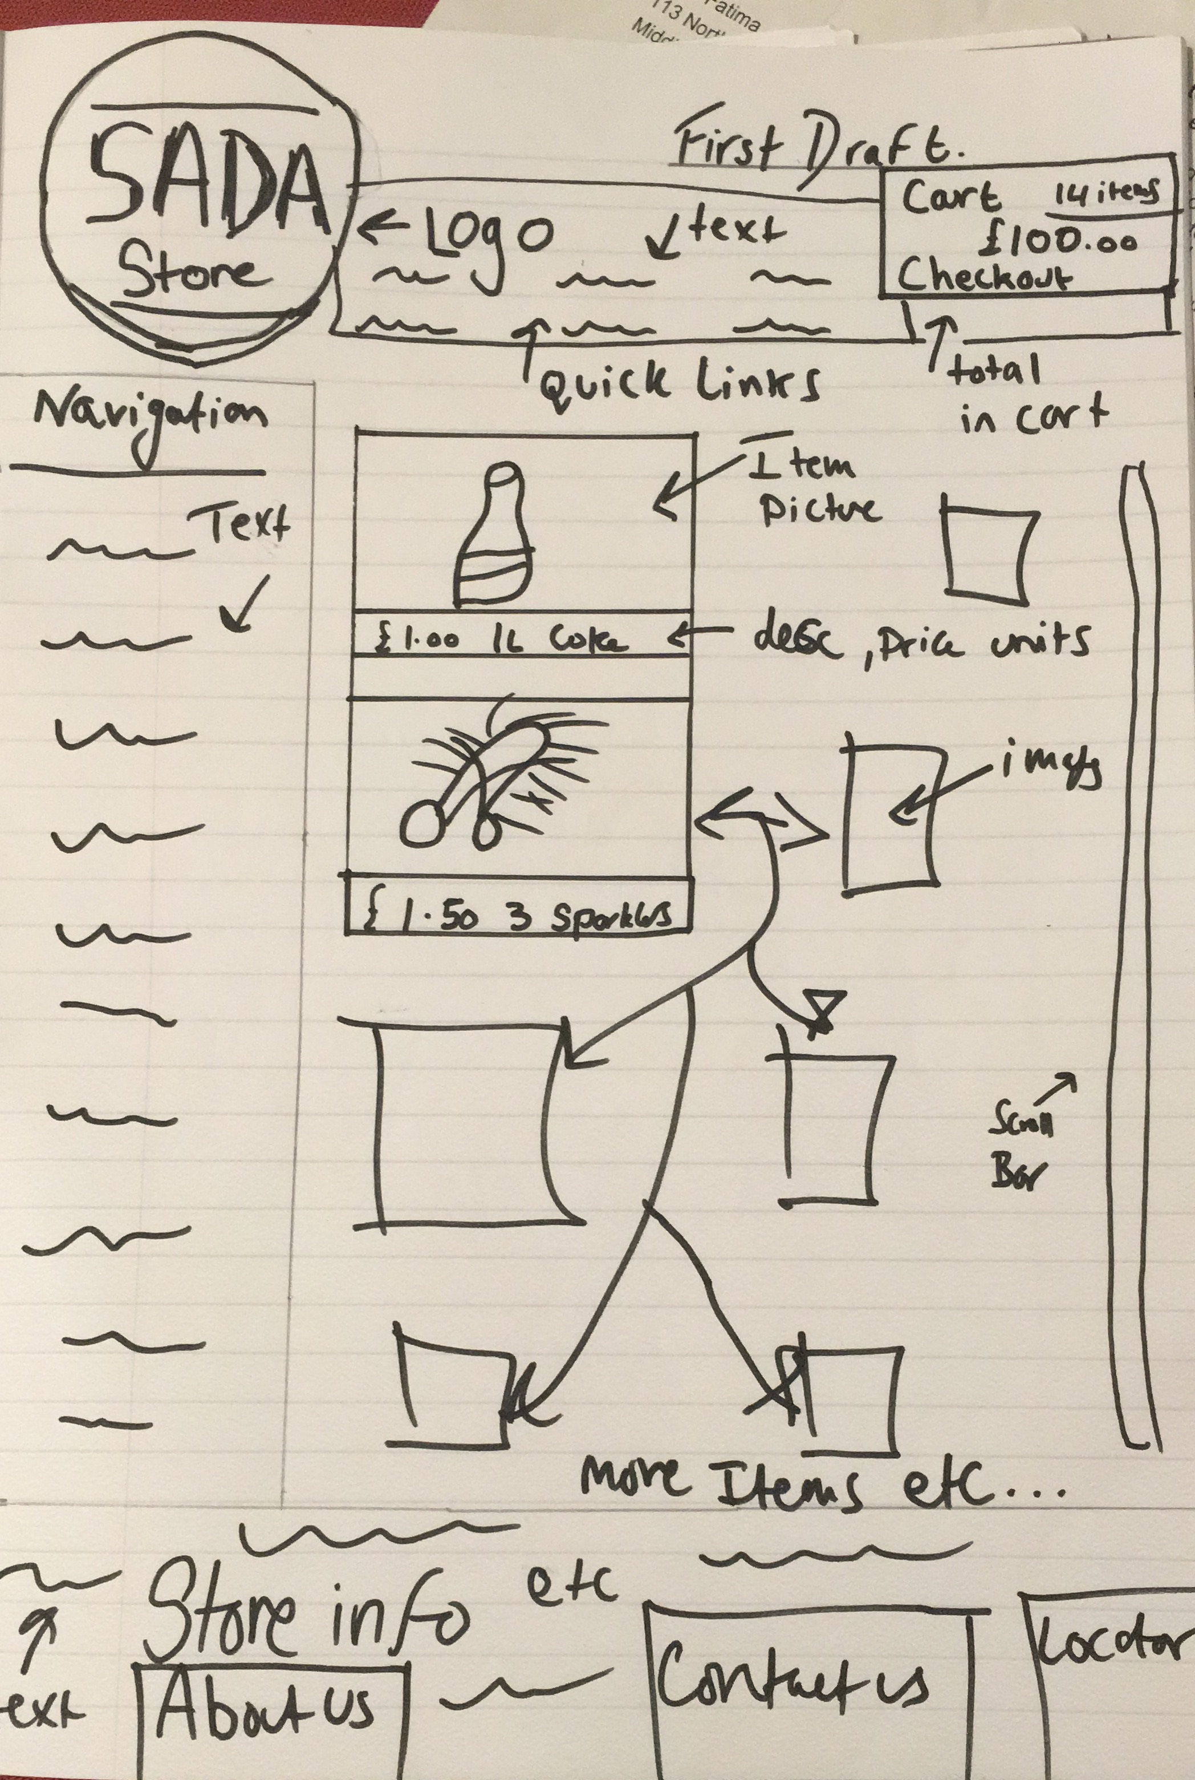
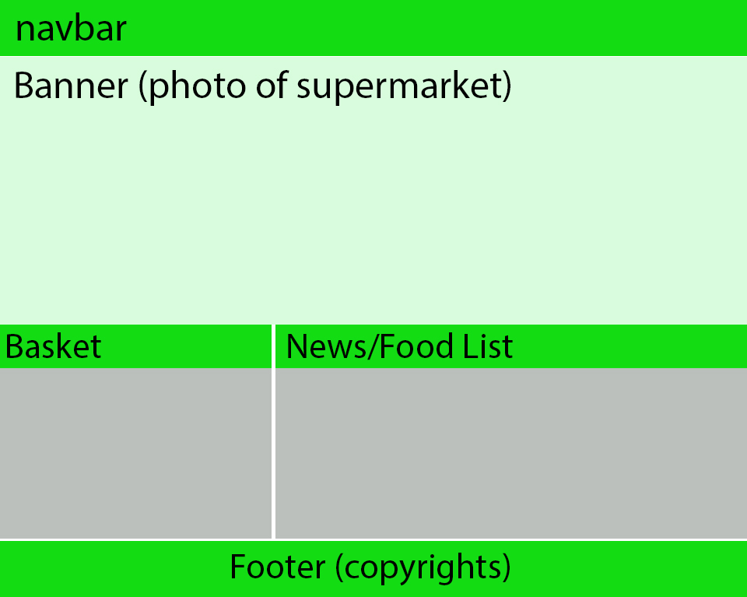
First Design

Slide 15
Draft Design

